Slide 1
Software QA and Testing with Automation using Selenium IDE Course 1, Class 1
Instructor
David F Wagoner
PMP, CSQE, CMQ/OE

Slide 2
Introductions
Course Objectives
Why are you taking the course and what you hope to get out of it?
What will you do with this knowledge upon course conclusion?
Textbook
Software Testing (2nd Edition); Paperback; Patton, Ron; 2006

Slide 3
Course 1 Objectives
An overall understanding of
Testing Life Cycle (TLC) within the Software Development Life Cycle (SDLC)
Quality Control (Testing, Verification and Validation) vs. Quality Assurance (Process Control and Effectiveness)
Different SDLC Models from Traditional (Waterfall) to Modern (Agile)
A detailed understanding of:
Testing Activities within the TLC/SDLC
Test Automation Prerequisites
Repeatable Automated Tests using Selenium IDE

Slide 4
Class Reading
Software Testing, 2nd edition
Chapter 1 – Software Testing Background
Chapter 2 – The Software Development Process
Chapter 3 – The Realities of Software Testing

Slide 5
Class Labs and Assignment
Using the processes and roles for testers, we’ll:
Develop Macro-based Test Scripts
Organize the scripts into a suite of automated tests
Your Lab will be to develop an automated test suite for a web site
Develop a web site to use in Part II of the course
Planning, requirements, design
Model/define the test data that will be used to test the site using MS Access
Your Assignment is to develop these documents and a database for test data
Test Plan, Requirements and Requirements Traceability Matrix
Demonstrate these and your automated tests in the final class

Slide 6
Terms
Requirement
New system functionality planned into a software release.
Enhancement
Improved existing system functionality
Bug/Defect/Anomaly/Abend
A malfunction of a system process. The longer time a bug goes undetected, the higher the cost to fix it.
Test Case/Script
A documented procedure or outline to follow when executing tests on specific system functions

Slide 7
Terms (cont)
Requirements Traceability
Refers to the document(s) that trace requirements to designs, program elements, test cases and test results
Scenario
A set of test execution activities that follow system business processes from end to end. Often, test cases and scripts will be organized to define a scenario

Slide 8
Terms (cont)
Test Plan
A document that details the testing effort in terms of requirements to test, fixed defects to test, test activities (test planning, design, construction, execution of scripts) as well as the overall schedule when not detailed elsewhere
Test Report
A document that details the results of testing including a defect list, delays to testing, items not tested and items deferred to future releases

Slide 9
Terms (cont)
Business Process
The business process is the set of end-to-end activities that occur to accomplish a task
A web site purchase is a business process
Process a Cart with contents
Validate Inventory Availability
Validate user, payment and shipping
Store the order and return a confirmation
Web sites have rapidly moved to use Service Oriented Architectures and Web Services to build business processes within and across industries and companies
The ACA requires combination and collating and processing information from CMS, the IRS, state governments and thousands of private companies, not to mention the web site!

Slide 10
Quality Assurance/Control
Quality Control (QC)
Verifies that something built in a previously executed activity is done correctly and defects are removed, when possible
Testing is a QC activity
Quality Assurance (QA)
QA audits projects to ensure all designated and scheduled activities occurred and produced designated work products (requirements and design documents, software, test documents…etc.)
Because of this mission, QA is often designated as the group managing the overall process
Designing, documenting, managing changes, publishing, training people and ensuring adherence to the process
Ensuring project personnel are aware of process requirements

Slide 11
Types of Testing (Verification and Validation)
Verification
Requirements and Design Verification
Unit Testing
Programmer level testing (Configuration Items (CI))
Integration Testing
Programmer Level testing of integrated units or Cis

Slide 12
Types of Testing (Verification and Validation)
Systems Testing
Testing done by a test team or requirements analysts to verify system functions, new requirements and fixed defects.
Regression Testing
Often part of Systems Testing. Verifies the elements of a system unchanged by new software continue to function as intended
Validation
Customer Acceptance Testing
Conducted by the end user to validate that all requirements have been delivered and function properly. Often involves validation that scheduled defects are corrected.

Slide 13
Test Failures
There are many instances of colossal failure linked to inadequate testing or failed testing approaches
Affordable Care Act Web Site Rollout
Disney Lion King Game
Y2K bug
All can be linked to inadequate or underfunded testing or lack of test time

Slide 14
Test Failures (cont)
Root Causes of failures
No testing planned or funded
Previous project phases/activities overran schedules and used up testing time and funding
Testing becomes hurried and harried
Quality is traded off for delivering on time
Poor test planning and execution processes
Organizations often undervalue testing
Poor defect management activities
Undocumented defects are easily overlooked
Many, particularly developers and their managers would prefer to reduce the visibility of testing and the defects uncovered

Slide 15
Successful Testing
Well-planned and funded testing activities/projects rarely produce colossal failures
Well-defined and understood SDLC
Well-defined, documented testing processes
Use industry standard Defect Management tools
Well-defined, documented test plans, scripts and scenarios

Slide 16
What is Testing?
A Quality Control (verification) activity that verifies proper software function prior to moving forward on a project
Within the SDLC, it is a ‘destructive’ or ‘deconstructive’ activity. All other SDLC activities are constructive.
Your job as tester is to break things other people have worked hard constructing. This is often a source of rancor on projects.
In this context, a tester can and should be as creative as possible to find ways to break software

Slide 17
Qualities of Good Testers
A natural sense of curiosity to creatively explore ways of using software that uncover problems
Must be a domain expert in testing and the software and the new requirements or enhancements to enable strong persuasion of others that don’t want to go ‘undo’ what they built and fix it
Must be a user advocate and press issues with tact and diplomacy
Be relentless but diplomatic in pushing for bug fixes, adequate schedule time and funding
Be a respected, responsible voice in readiness reviews
Do not alienate others with terms and foster rancor, your success depends on others more so than any other professional on the team. The more they want to work with you and want to share more information with you, the more successful you become.

Slide 18
Testing Roles on Projects
Test Manager
In larger organizations a manager helps to coordinate resources with other teams and projects
Test Lead
Manages tactical test efforts on projects, ensuring testing is planned, documented and executed properly.
Test Analyst
Develops test cases, maintains RTM, executes manual and automated testing
Roles
Requirements Analyst
Test Lead
Test Analysts (may be same as Requirements Analyst
Customer
Instructor will be the developer and a customer

Slide 19
Testing Responsibilities
Develop Test plans and ensure they are integrated with other related groups on the project AND reflected properly in the schedule
Develop and help maintain the RTM, updating as test cases and scenarios are developed
Participate in reviews
Requirements, Design
Readiness
Design, Coding, Testing, User Acceptance
Manage the Testing phase and code rework cycle
Often manages meetings to correct defects

Slide 20
Our Project – The Voracious Validators
We’ll put together a virtual team comprised of a Test Lead, Test Analysts, Requirements Analysts and the customer
In the next section on the process, we’ll discuss what these different roles do

Slide 21
The SDLC
The SDLC
Defines the major phases of a software development project
May have a conceptual phase before planning
May have a user acceptance phase for systems developed for a specific client(s)
There are many different models that have similar phases
Disregard Big Bang and Code and Fix from textbook

Slide 22
Common SDLC Phases
Regardless of the specific model, software projects use phases like these, in one form or term or another
Planning
Defines what we are doing
Integrate distinct groups and integral processes to the project
Requirements Development
Defines what we are building
Design
Defines how we are building the software
Coding or Implementation
Build it
Systems Testing
Verify what we built is correct
User Acceptance Testing
Did we build the right thing?
Does it perform aligned with requirements
Deployment
Deliver and checkout what was built

Slide 23
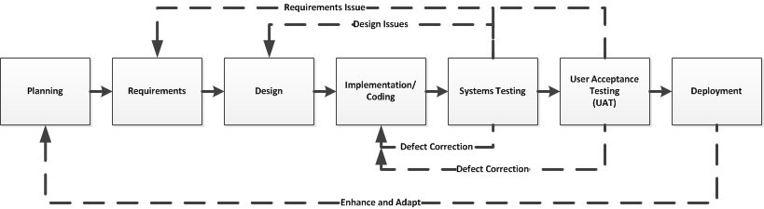
SDLC Phases with Test Rework
This represents the looping that can occur when:
A defect is encountered
A requirement is not met
The later in the process these are seen, the greater the cost to remediate
To:
Correct defects (expensive)
Or designs and requirements (more expensive)
Enhance the software based on evolving user needs or software problems (very expensive)

Slide 24
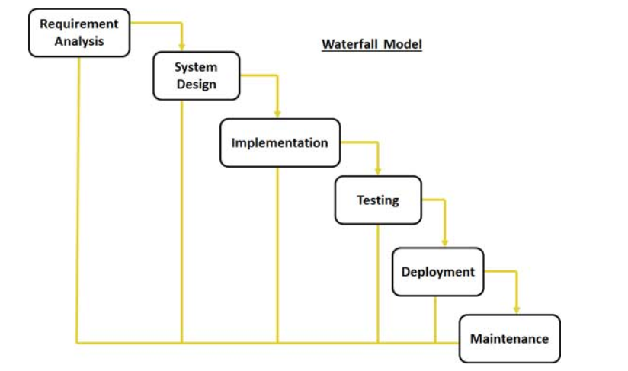
SDLC Models (Waterfall)
This is the oldest and simplest model. Phases occur one after another, which does not always model real-world projects
Image courtesy of tutorialpoints.com

Slide 25
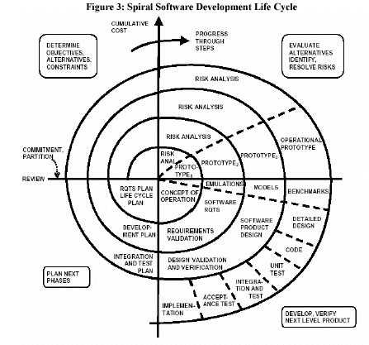
SDLC Models (Spiral)
The Spiral model is a more realistic model that still has phases similar to Waterfall, but lays the phases out in multiple iterations with risk management and re-planning between phases that enhances risk management
Image courtesy of FDIC OIG Audits

Slide 26
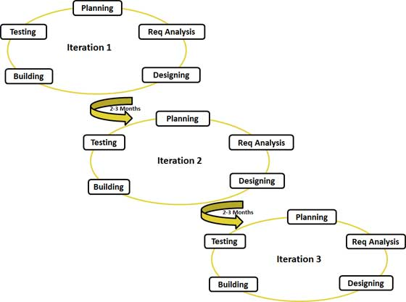
Agile SDLC
Agile Iterative Model
Image courtesy of tutorialpoints.com

Slide 27
SDLC Models (Agile)
The Agile model is the most modern and is widely used today by leading software organizations. It provides a shorter time-to-deployment with more requirements delivered than traditional models like Waterfall and Spiral
It is almost a combination of Waterfall and Spiral with less documentation and overhead
Agile is:
Adaptive instead of predictive
Iterative instead of waterfall
Value code instead of documentation

Slide 28
SDLC Models (Agile - cont)
Agile is based on a Manifesto that sought to overcome difficulties in projects by aligning to a set of engineering values:
Our highest priority is to satisfy the customer through early and continuous delivery of valuable software.
Welcome changing requirements, even late in development. Agile processes harness change for the customer's competitive advantage.
Deliver working software frequently, from a couple of weeks to a couple of months, with a preference to the shorter timescale.
Business people and developers must work together daily throughout the project.

Slide 29
SDLC Models (Agile - cont)
Manifesto (cont.)
Build projects around motivated individuals. Give them the environment and support they need, and trust them to get the job done.
The most efficient and effective method of conveying information to and within a development team is face-to-face conversation.
Working software is the primary measure of progress.
Agile processes promote sustainable development. The sponsors, developers, and users should be able to maintain a constant pace indefinitely.

Slide 30
SDLC Models (Agile - cont)
Manifesto (cont.)
Continuous attention to technical excellence and good design enhances agility.
Simplicity--the art of maximizing the amount of work not done--is essential.
The best architectures, requirements, and designs emerge from self-organizing teams.
At regular intervals, the team reflects on how to become more effective, then tunes and adjusts its behavior accordingly

Slide 31
SDLC Integral Processes
These processes interweave with the main phases and provide engineering support to the main development team
Configuration Management
Quality Assurance
Documentation Development
Training Development, if applicable
Testing is often considered an integral process but is different in that it has a main phases in the SDLC

Slide 32
Testing Life Cycle
The testing lifecycle roughly correlates to similar phases of SDLC
Test planning is conducted during the Planning phase
Requirements for testing are documented during Requirements Development phase
Test case/script design occurs during the Design phase
Test case construction occurs during the Coding or Implementation phase
Test execution occurs during the Systems Test phase
If User Acceptance Testing is applicable, it is performed prior to delivery and is supported by the Testing Team

Slide 33
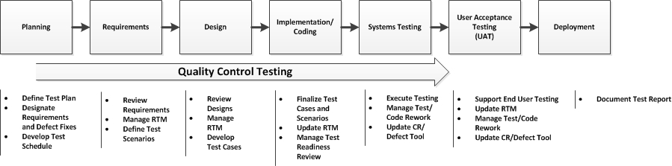
Testing Life Cycle/Integral Process

Slide 34
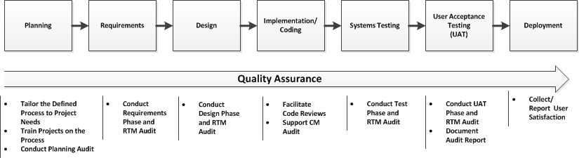
QA Life Cycle/Integral Process

Slide 35
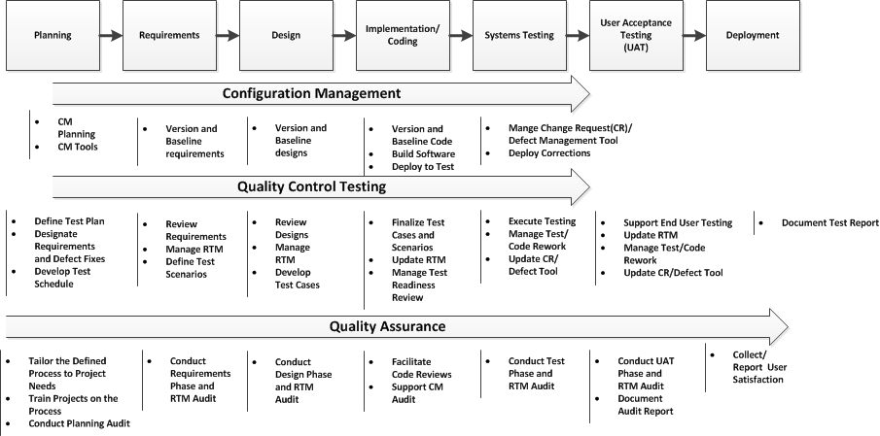
All Life Cycles/Integral Processes

